Slide 1

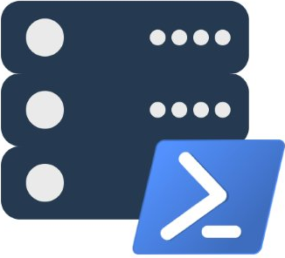
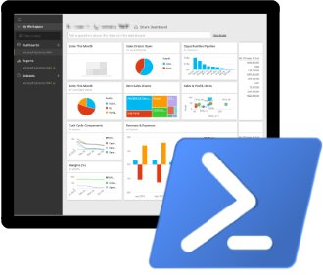
PowerShell ❤ SQL Server Building the Modern DBA’s Toolset
Presented by
Chrissy LeMaire and Rob Sewell

Slide 2
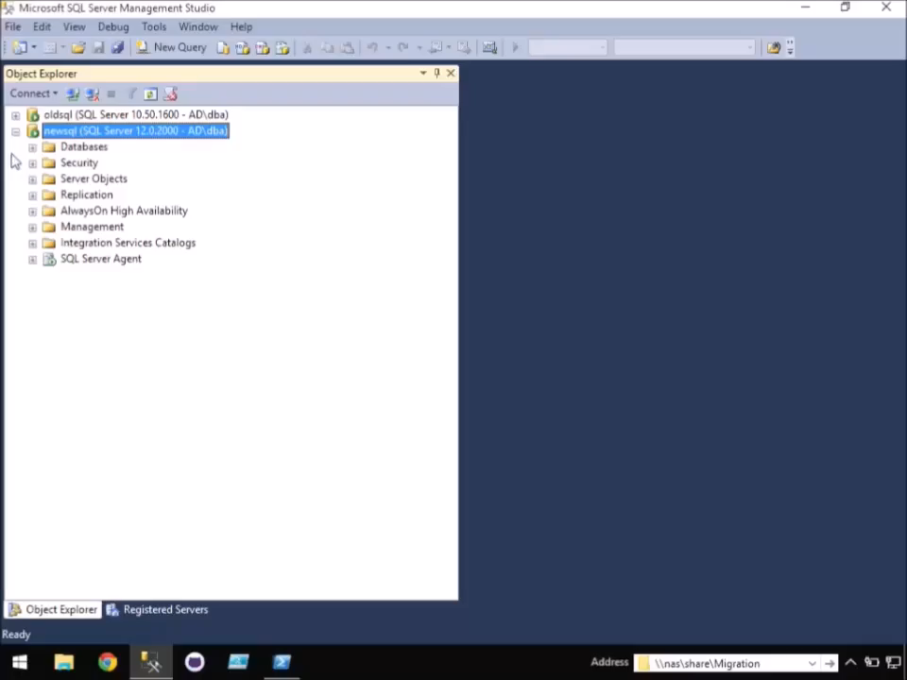
-WhatIf SQL Server Migrations went more like this…
dbatools.io | dbareports.io | sqlps.io | sqlps.io/slack | sqlps.io/vienna

Slide 3
Agenda - dbatools
Who
Requirements
Hella Demos
1
2
3
4
5
6
Overview
Install
Questions!
dbatools.io | dbareports.io | sqlps.io | sqlps.io/slack | sqlps.io/vienna

Slide 4




whoami
Chrissy LeMaire, Microsoft PowerShell MVP
Sr. Systems Engineer/DBA for General Dynamics IT at NATO Special Ops HQ in Belgium
SQL Server since 1999 and PowerShell since 2005
Email: clemaire@gmail.com
Profile:
Chrissy LeMaire
@cl
Tech:
netnerds.net, dbatools.io
Food:
RealCajunRecipes.com
dbatools.io | dbareports.io | sqlps.io | sqlps.io/slack | sqlps.io/vienna

Slide 5

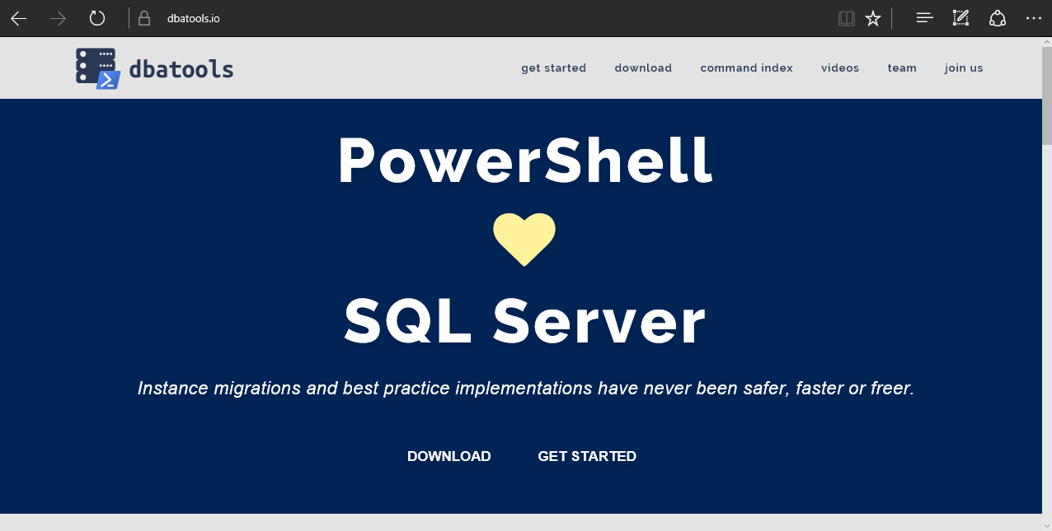
dbatools
dbatools.io | dbareports.io | sqlps.io | sqlps.io/slack | sqlps.io/vienna
Notes:
Community project, initially started out as Start-SqlMigration but has grown into a DBA’s best friend. dbatools currently sports 100 commands.
How many of you have heard of dbatools? How many of you have used it?

Slide 6
System Requirements
Minimum
Client
PowerShell v3
SQL Server Management Studio 2008 R2
Server
SQL Server 2000
Recommended
Client
PowerShell v5
SQL Server Management Studio 2012+
Server
SQL Server 2005+
dbatools.io | dbareports.io | sqlps.io | sqlps.io/slack | sqlps.io/vienna
Notes:
Started as a migration tool, so I strived to support older environments
No reliance on SQLPS, because we’ve got a history ;)

Slide 7
Install is easy
PowerShell Gallery
Install-Module dbatools
Install-Module dbatools –Scope CurrentUser
GitHub – dbatools.io/git
Invoke-Expression (Invoke-WebRequest https://dbatools.io/in)
Clone repo found at dbatools.io/git, Import-Module dbatools
dbatools.io | dbareports.io | sqlps.io | sqlps.io/slack | sqlps.io/vienna
Notes:
Gallery requires admin access and is built into PowerShell v5. Other versions also support it with a bit of configuration.
Download
Unzip
Import-Module

Slide 8
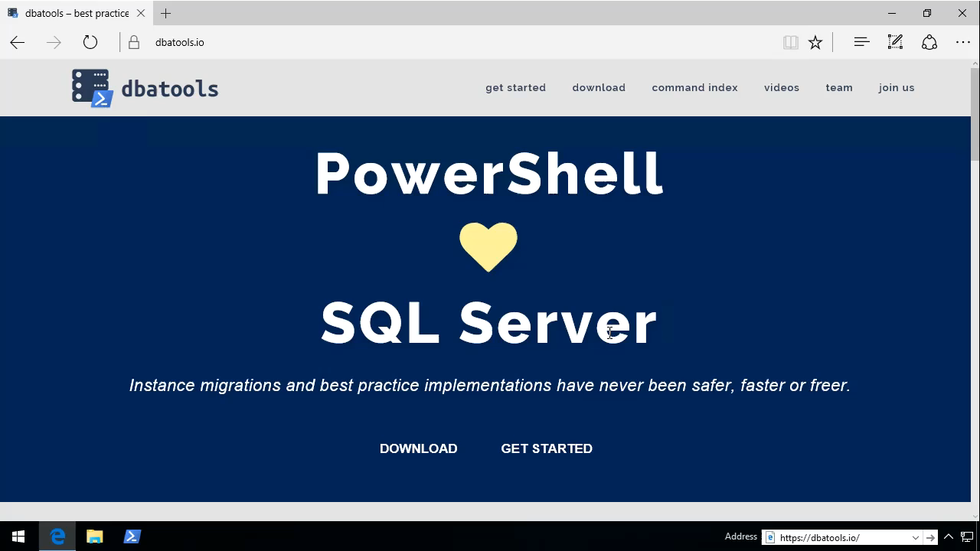
See?
dbatools.io | dbareports.io | sqlps.io | sqlps.io/slack | sqlps.io/vienna

Slide 9
Support
SQL Server 2000 – vNext
Express – Datacenter Edition
Clustered and stand-alone instances
Windows and SQL authentication
Default and named instances
Multiple instances on one server
Auto-populated parameters for command-line completion (think -Databases and -Logins)
dbatools.io | dbareports.io | sqlps.io | sqlps.io/slack | sqlps.io/vienna

Slide 10
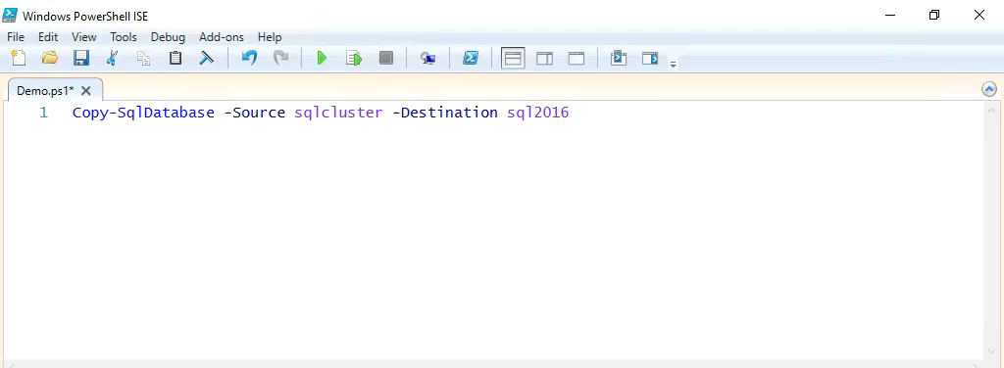
Support
dbatools.io | dbareports.io | sqlps.io | sqlps.io/slack | sqlps.io/vienna

Slide 11
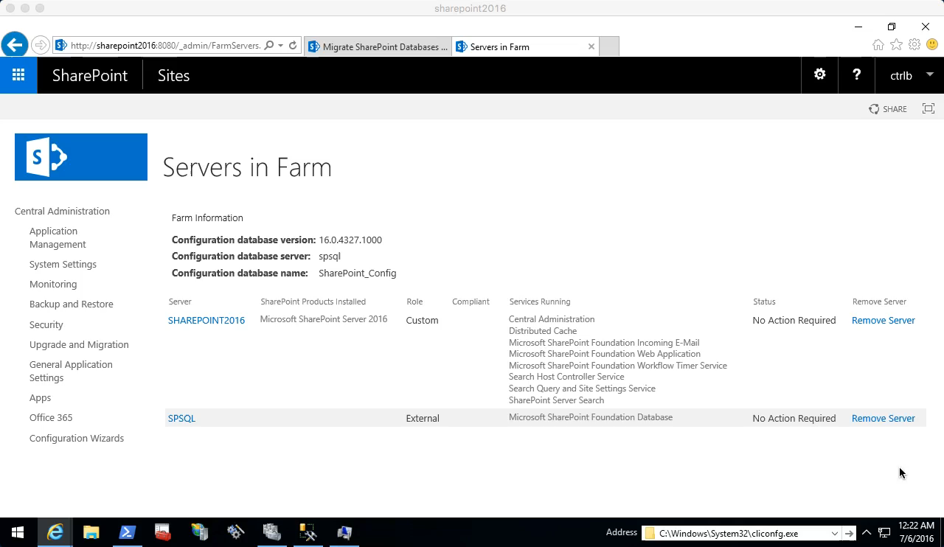
Start-SqlMigration
dbatools.io | dbareports.io | sqlps.io | sqlps.io/slack | sqlps.io/vienna

Slide 12

Start-SqlMigration
dbatools.io | dbareports.io | sqlps.io | sqlps.io/slack | sqlps.io/vienna

Slide 13
SQL Server Administration and Best Practices
demo

Slide 14


dbareports.io
Rob Sewell
dbatools.io | dbareports.io | sqlps.io | sqlps.io/slack | sqlps.io/vienna

Slide 15
whoami
Rob Sewell
PowerShell, Azure, Automation and SQL (PaaS Geddit ? ☺ )
Email: mrrobsewell@outlook.com
Profile:
Rob Sewell
@sqldbawithbeard
Tech:
sqldbawithabeard.com dbareports.io
dbatools.io | dbareports.io | sqlps.io | sqlps.io/slack | sqlps.io/vienna

Slide 16
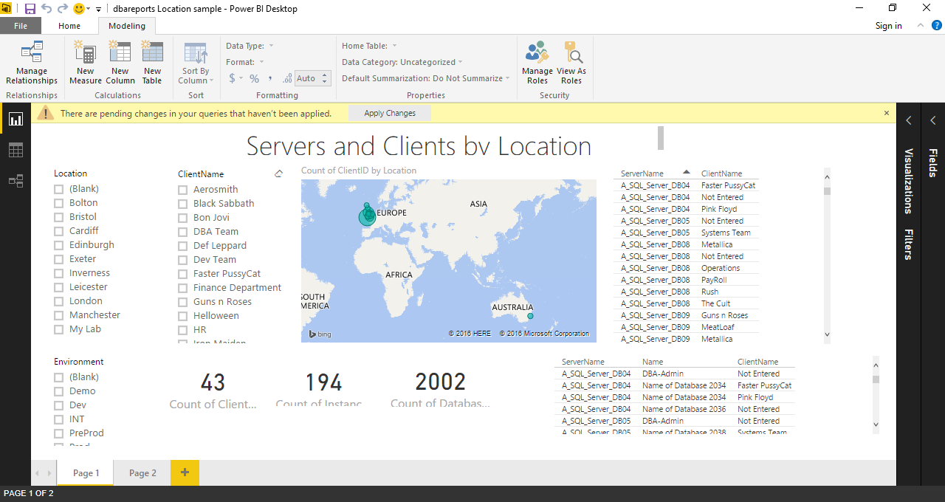
dbareports.io
dbatools.io | dbareports.io | sqlps.io | sqlps.io/slack | sqlps.io/vienna

Slide 17
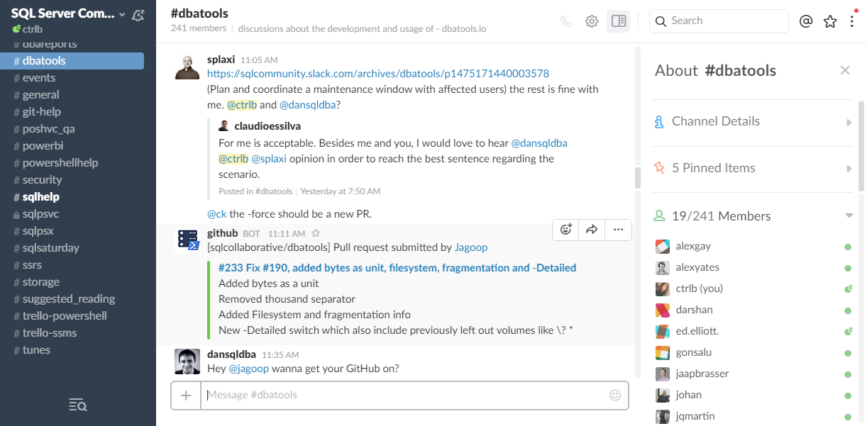
Join us! - dbatools.io/slack
dbatools.io | dbareports.io | sqlps.io | sqlps.io/slack | sqlps.io/vienna

Slide 18
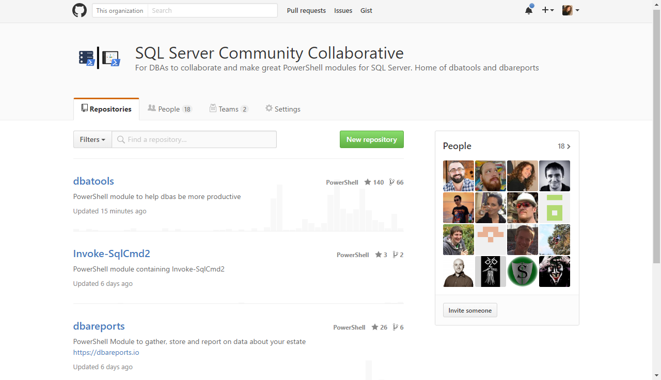
Join us! – github.com/sqlcollaboratve
dbatools.io | dbareports.io | sqlps.io | sqlps.io/slack | sqlps.io/vienna

Slide 19

Community got us feelin’ like
dbatools.io | dbareports.io | sqlps.io | sqlps.io/slack | sqlps.io/vienna
Notes:
Cut it out.

Slide 20
Review
PowerShell is a DBA’s best friend Migrations Best Practices Reporting
Join us! dbatools.io/slack #dbatools #dbareports
dbatools.io | dbareports.io | sqlps.io | sqlps.io/slack | sqlps.io/vienna

Slide 21
How to Get-Help
Extensive documentation within each command Get-Help Start-SqlMigration –Detailed
Extensive documentation on dbatools.io
dbatools.io/Start-SqlMigration
dbatools.io/Repair-SqlOrphanUser
Some commands have videos
dbatools.io/youtube
dbatools.io | dbareports.io | sqlps.io | sqlps.io/slack | sqlps.io/vienna

Slide 22














Our Sponsors
Notes:
If you think, that a SQL Saturday is a nice possibility to learn from and network with fellow SQL Server enthusiasts FOR FREE,
I just ask you one thing: Visit the sponsor booths and chat with the sponsors!
They are covering the expenses for each and every of you, with is around EUR 60 …

